Slide 1
See it Learn
180041105 – Ishmam Tashdeed
180041109 – Tauseef Tajwar
180041111 – Muftiqur Rahman Agni
180041120 – Md Farhan Ishmam

Slide 2
Humans Are Visual Creatures
Notes:
The human brain is not well equipped to devour so much raw, unorganized information such as large corpus of texts. Humans are visual learners i.e. we happen to retain information more efficiently from visual sources than other sources such as reading, hearing etc.

Slide 3
Anatomically we are designed to learn visually!
Half of the human brain is directly or indirectly devoted to processing visual information.
The brain can identify images seen for as little as 13 milliseconds.
People can remember more than 2000 pictures with at least 90 % accuracy in recognition tests
Notes:
There is a trick in this slide. Each point is associated to a separate color and you can remember this association to remember the information of the points which is an example of good your brain is at retaining visual information.

Slide 4
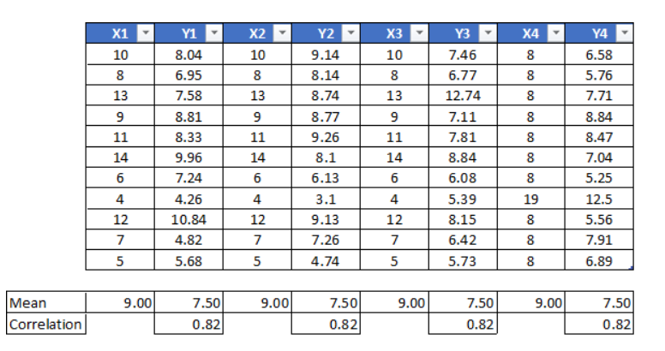
Tables aren’t meant to be comprehensible…
Notes:
Let’s have a look at the most common form of structures data - a table. When we look at it, all our brain sees is just a bunch of numbers. We think over and over again what these numbers mean and may or may not come up with some reasonable explanation depending on our mental aptitude. But the point remains the same – it is unpleasant to look at and inferring from the table is inefficient.

Slide 5
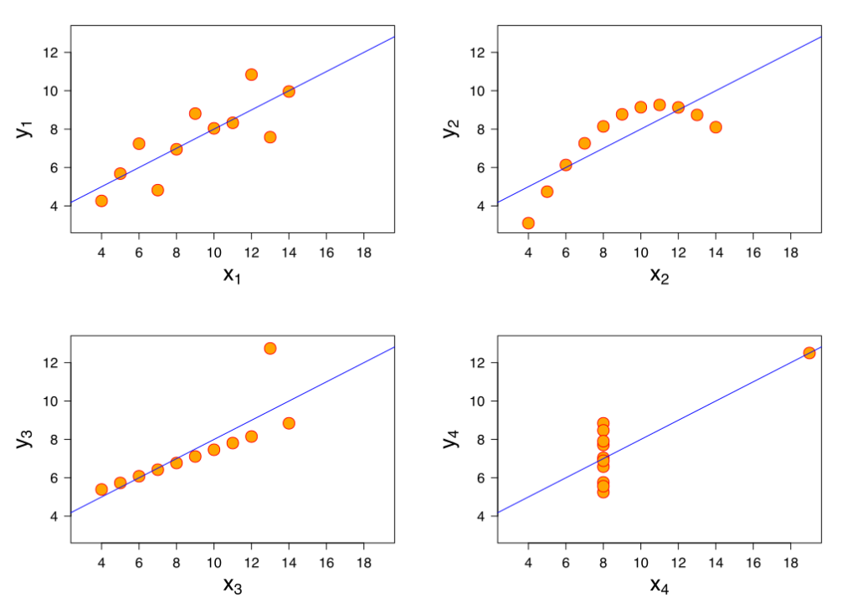
Visualization has more information!
Notes:
Now what can we see? Almost everything that was happening in the table and maybe more. All in the blink of an eye. If I change the slide right now, you will remember most of the information from the visualization. But did you remember anything from the table?

Slide 6
What we see
Description of Linear Classifier Decision Boundaries:
The linear classifier model draws a linear boundary between regions of dissimilarity. In case of having two dissimilar classes, the final boundary will be a straight line that divides the whole region in two parts. The linear boundary is calculated based on the weight and as the weights starts off with zero, the linear boundary will also be at the x-axis i.e. it is producing zero as output for every value of x. As the model gets trained, linear boundary iteratively gets closer to the actually dividing the regions of dissimilarity. The linear boundary tends to change rapidly at the beginning but begins to lose it’s pace as it reaches close to the global minimum.
Notes:
Here’s, another example but this time, with a large corpus of text; something which we commonly see in our books and slides. What do we see?

Slide 7
What we actually see
Description of Linear Classifier Decision Boundaries:
The linear classifier model draws a linear boundary between regions of dissimilarity. In case of having two dissimilar classes, the final boundary will be a straight line that divides the whole region in two parts. The linear boundary is calculated based on the weight and as the weights starts off with zero, the linear boundary will also be at the x-axis i.e. it is producing zero as output for every value of x. As the model gets trained, linear boundary iteratively gets closer to the actually dividing the regions of dissimilarity. The linear boundary tends to change rapidly at the beginning but begins to lose it’s pace as it reaches close to the global minimum.
Notes:
But here’s what’s actually happening! We don’t focus on every piece of text in the paragraph. We can’t remember every single word! We just try to find the important ones to remember and may or may not find all the important ones. Here the words marked in red seem reasonable enough to be considered important by an average use but the line in blue is something that might get ignored which does have a lot of importance when trying to conceptualize the algorithm.

Slide 8
Why all the extra steps?
We are just focusing on certain parts of the text and then trying to visualize the whole text
Instead…
Let’s just show this
Notes:
We focus on certain parts only. Important or unimportant, we don’t know that yet. In the limited amount of time we have, we take the gamble of finding the correct words to focus in time. Then we try to conceptualize the whole thing visually. But why do we need to do all these extra steps and instead just….
[Introduce the next speaker]

Slide 9
Our Objectives
Goal
Provide a tool that can visualize Machine Learning Algorithms and allow students to interact with them
Focus
Quality Visualizations through Animations where possible
Vision
A study environment where the student can have a visual understanding and emerge himself/herself in the learning process
Being easily Interactive and conceptually Intuitive
Notes:
[Change of Speaker] Now, we know the problem. Our education system is entangled in such a non-visual study methodology. And here, comes our solution.

Slide 10
Core Features
Best form of visualization for popular learning algorithms
Multiple randomly generated dataset of various shapes
9 learning algorithms and can be modularly extended
Ease of access by deploying as a webapp
Interactive widgets to change hyperparameters

Slide 11
Technologies
Language
Python
- Most popular language for machine learning
- Lots of open-source library for optimized ML algorithms
- Great community support for development
Platform
Jupyter Notebook
- Web-based and interactive environment for Python
- Supports code, texts, plots, and rich media
- Great development environment and easily replicable

Slide 12
Python Libraries we used
Front End
Ipywidgets
Ipython
Back-End
Numpy
Scipy
Deployment
Voila
Matplotlib
Seaborn
Pandas
Scikit-learn

Slide 13
Algorithms we showcased
Supervised
Linear Regression
Logistic Regression
Unsupervised
K-Means Clustering
Neural Networks
Linear SVM
Non-Linear SVM
Naïve Bayes
Decision Tree
Principal Component Analysis (PCA)

Slide 14
Project Demonstration

